Slide 1
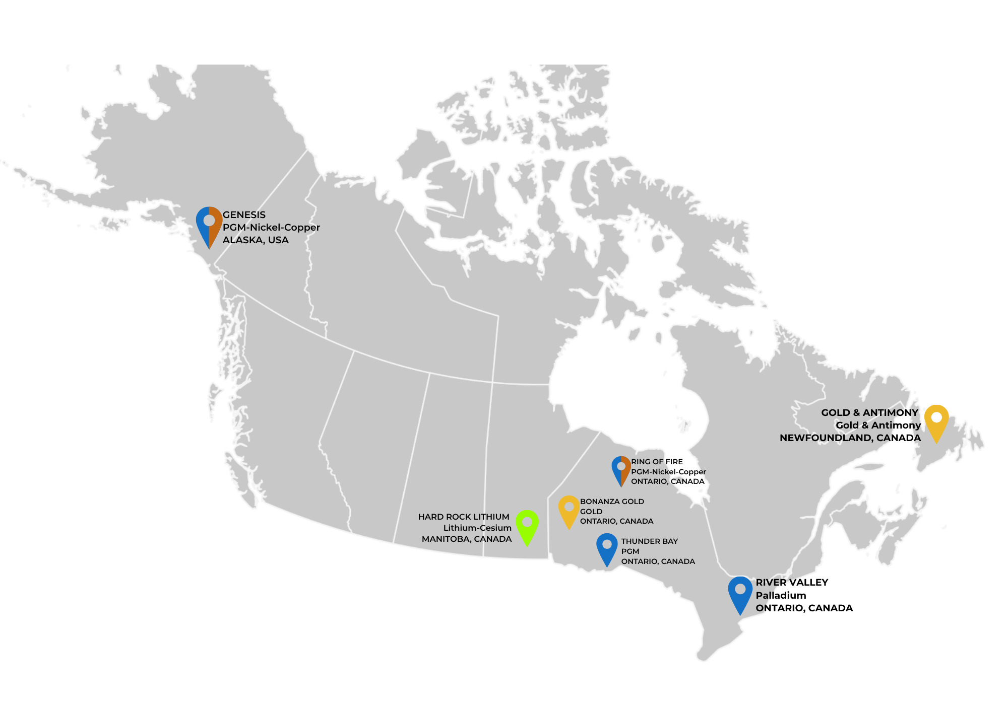




TSXV: NAM
OTCQB: NMTLF
FSE: P7J
At the Forefront of Critical and Precious Metals Exploration
PALLADIUM
PLATINUM
RHODIUM
GOLD
COPPER
NICKEL
ZINC
www.NewAgeMetals.com
GOLD
COPPER
ANTIMONY
SILVER
LITHIUM
CESIUM
TANTALUM

Slide 2
DISCLAIMERS
SAFE HARBOUR STATEMENT
This report includes forward-looking statements covered by the Private Securities Litigation Reform Act of 1995. Because such statements deal with future events, they are subject to various risks and uncertainties and actual results for fiscal year 2010 and beyond could differ materially from the Company’s current expectations. Forward-looking statements are identified by words such as "anticipates," "projects," "expects," "plans," "intends," "believes," "estimates," "targets," and other similar expressions that indicate trends and future events.
FORWARD-LOOKING STATEMENTS
Certain information presented, including discussions of future plans and operations, contains forward-looking statements involving substantial known and unknown risks and uncertainties. These forward-looking statements are subject to risk and uncertainty, many of which are beyond control of company management. These may include, but are not limited to, the influence of general economic conditions, industry conditions, fluctuations of commodity prices and foreign exchange rate conditions, prices, rates, environmental risk, industry competition, availability of qualified staff and management, stock market volatility, timely and cost-effective access to sufficient working capital or financing from internal and external sources. Actual results, performance, or achievements may differ materially from those expressed or implied by these forward-looking statements
QUALIFIED PERSON STATEMENT
The information in this presentation that relates to Exploration Results or Mineral Resources at the River Valley Palladium Project is based on information compiled, reviewed or prepared by Dr. Bill Stone. Dr. Stone is a Qualified Person, as defined by National Instrument 43-101, and has reviewed and approved the technical content of this presentation.
The information in this presentation also relates to Exploration Results or Mineral Resources at Manitoba Lithium Project is based on information compiled, reviewed or prepared by Lynde Guillaume. Lynde Guillaume is a Qualified Person, as defined by National Instrument 43-101, and has reviewed and approved the technical content of this presentation.
H2 2026
H2 2026

Slide 3


Project Summary
Thunder Bay PGM–Ni–Cu, Ontario
  Platreef/ Gravel Ridge project expanded to ~21,000 hectares (~52,000 ac) , complementing Escape East project near the Clean Air T-Bay North (1.274m-oz of Pt+Pd, 60k t of Cu & 36k t of Ni
  Well established mining district, excellent infrastructure
  Fall program with boots on ground / geophysics
Gold & Critical metals – Bonanza Ridge Project, Kenora
  District-scale gold project with high-grade historic workings
  Aggressive regional exploration program underway
  Second district scale Double R Gold project
  Goal to identify drill targets for early 2027
Gold–Antimony – Newfoundland
  11 projects in a top-tier mining jurisdiction
  High-grade gold and critical antimony focus
  Aggressive acquisition & exploration programs underway
  Drill ready by early 2027
Lithium | Tantalum | Cesium | Beryllium – Manitoba
  100% NAM ownership via Lithium Canada Development
  $11m spent to date. Numerous drill targets, $3m geological / drill budget recommended
~14.39% equity interest in MetalQuest Mining Inc.
(Lac Otelnuk/Superior Iron/Ring of Fire/Cameron)
Strategic Shareholder​
Eric Sprott one of the world’s best known mining financiers and owns +30%​
Core Asset Divisions​
Flagship PGM – River Valley (Ontario)​
  100% owned, multi-million-ounce Pd–Pt–Rh–Cu–Au district​
  ~60 road miles from Sudbury, North America’s largest metallurgical complex​
  2026 Program includes 3D IP Geophysical survey to generate high-priority drill targets
  PLATSOL studies to increase metallurgical recoveries
  Pathway to feasibility study
Northern Shield PGM–Ni–Cu – Ring of Fire, Ontario
  Northern Shield now totals ~34,000 hectares (84,000 acres) following southern extension and northern extension.
  Government begins construction of an all-season access road in September 2026
Genesis Cu–Ni–PGM (Alaska)​
  100% owned, road-accessible, drill-ready​
  August 2026 exploration program completed, results by year end​
H2 2026
NEWAGEMETALS.COM • TSX.V: NAM • OTCQB: NMTLF • FSE: P7J2
H1 2026

Slide 4
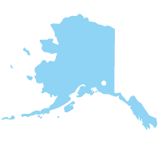

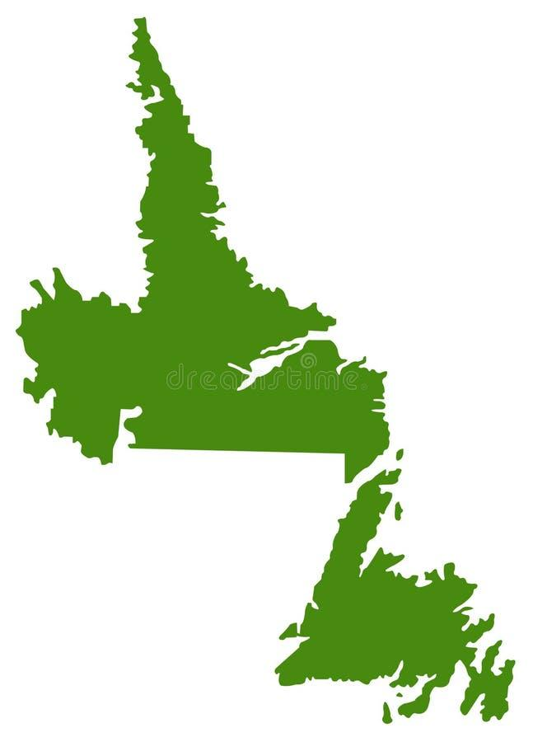

DIVERSIFIED PORTFOLIO,
GOLD & CRITICAL METAL FOCUS
PLATINUM GROUP METALS DIVISION
RIVER VALLEY PALLADIUM PROJECT
SUDBURY REGION, ONTARIO, CAN
GENESIS PGM-COPPER-NICKEL PROJECT
ALASKA, USA
Northern Shield PGM-Copper-Nickel Project
RING OF FIRE, ONTARIO, CAN
Thunder Bay PGM-Copper-Nickel Projects
ONTARIO, CAN
GOLD DIVISION
BONANZA RIDGE GOLD PROJECT
DOUBLE R GOLD PROJECT
KENORA MINING DISTRICT, ONTARIO
NEWFOUNDLAND DIVISION
LITHIUM DIVISION
CRITICAL METALS – GOLD AND ANTIMONY
NEWFOUNDLAND AND LABRADOR, CAN
LITHIUM AND RARE ELEMENT PROJECTS
MANITOBA, CAN
H2 2026
H2 2026
Notes:
Change Genesis Project to Property

Slide 5
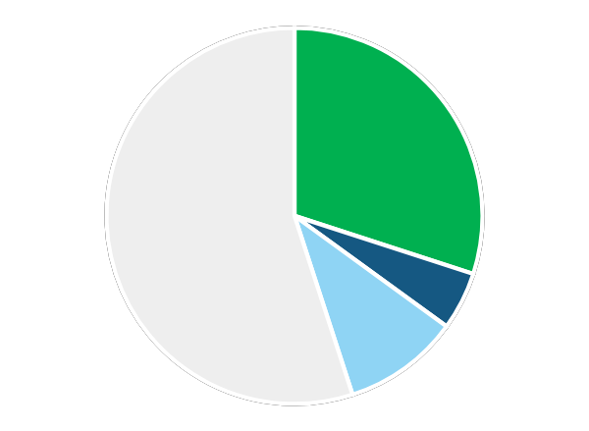


New Age Metals CORPORATE OVERVIEW
CAPITAL STRUCTURE
SHAREHOLDERS
73,051,742
ISSUED & OUTSTANDING
ERIC SPROTT (~30%)
5,269,999
OPTIONS
MANAGEMENT (~5%)
9,150,052
WARRANTS
INSTITUTIONAL (~10%)
87,471,794
FULLY DILUTED
RETAIL (~55)% ²
APPROX. $16.4M
MARKET CAP (CAD)
CASH + Marketable Securities
July 2026
$0.23
SHARE PRICE ¹
~$4,900,000
NO DEBT
Analyst Coverage
Siddharth Rajeev, B.Tech, MBA, CFA
ResearchFRC.com
¹ as of September 3rd , 2026
² approx. 7,000 shareholders
H2 2026
H2 2026

Slide 6
BOARD OF DIRECTORS
HARRY BARR
CHAIRMAN & CEO
Founder, Chairman and CEO of International Metals Group
40+ years of experience in the mining industry, focus on acquisition, finance and development of mineral projects on international scale
Oversaw over 300 option/joint venture agreements with major, mid-tier, and junior mining companies
COLIN BIRD
DIRECTOR
50+ years of international experience in developing, financing, operating and managing nickel, copper, gold and coal mines
A UK-chartered mining engineer
Currently serving as Non-Executive Chairman of Jubilee Metals Group, Executive Chairman of Xtract Resources, Galileo Resources, Bezant Resources and Tiger Royalties and Investments
CHRIS BERLET
DIRECTOR
Currently serving as the President & CEO, Director of Canuc
Resources, and Stakeholder Gold Corp.
35 years of experience in both finance and the mineral industries
Graduate of Mining Engineering from Queen’s University
(Canada); Diploma in Accounting & Finance from London School of Economics and Political Science (UK); CFA Charter Holder (USA)
CURT FREEMAN
DIRECTOR
Mr. Freeman is a U.S. Certified Professional Geologist with 40+ years of experience as a professional geologist in the State of Alaska.
Since forming Avalon Development in 1985, Curt and his crews have conducted mineral exploration all over Alaska as well as in the Yukon, the western United States, Central America, South America, New Zealand and Africa.
RON HIEBER
DIRECTOR
45+ years of experience on the international scale as a professional geologist
Former head of worldwide exploration for Anglo Platinum
Internationally recognized expert in Platinum Group Metals
Geology graduate of Rhodes University, South Africa.
H2 2026

Slide 7

NEW AGE METALS Senior Management Team
HARRY BARR
CHAIRMAN & CEO
MAX KACZMER P. Geo.
SENIOR GEOSCIENCE CONSULTANT
ALI HASSANALIZADEH, M.Sc., P. Geo., MBA
ADVISORY BOARD, CONSULTING GEOLOGIST
ROBERT GUANZON
CHIEF FINANCIAL OFFICER
RICHARD ZEMOROZ
SENIOR PROJECT GEOLOGIST
PAUL POGGIONE, CIM
STRATEGIC DEVELOPMENT
CHARLOTTE BROWN
CORPORATE SECRETARY
GORDON CHUNNETT, B.Sc.
PGM SPECIALIST, ADVISOR
AXIOM EXPLORATION,
MULTI DISCIPLINARY CONSULTING GROUP
RON HEBERT
LEAD DIRECTOR, PGM SPECIALIST
CURT FREEMAN
LEAD DIRECTOR, ALASKA GEOSCIENCE EXPERT
CLARK EXPLORATION,
GEO CONSULTING GROUP | SPECIALIST IN NW ONTARIO
DOUG BUNDY,
MANAGER, EXPEDITOR,
PROSPECTOR (NW ONTARIO)
CRAIG RAVNAAS
SENIOR CONSULTING GEOLOGIST (NW ONTARIO
DAVE SALARI
SENIOR METALLURGICAL CONSULTANT
H2 2026

Slide 8
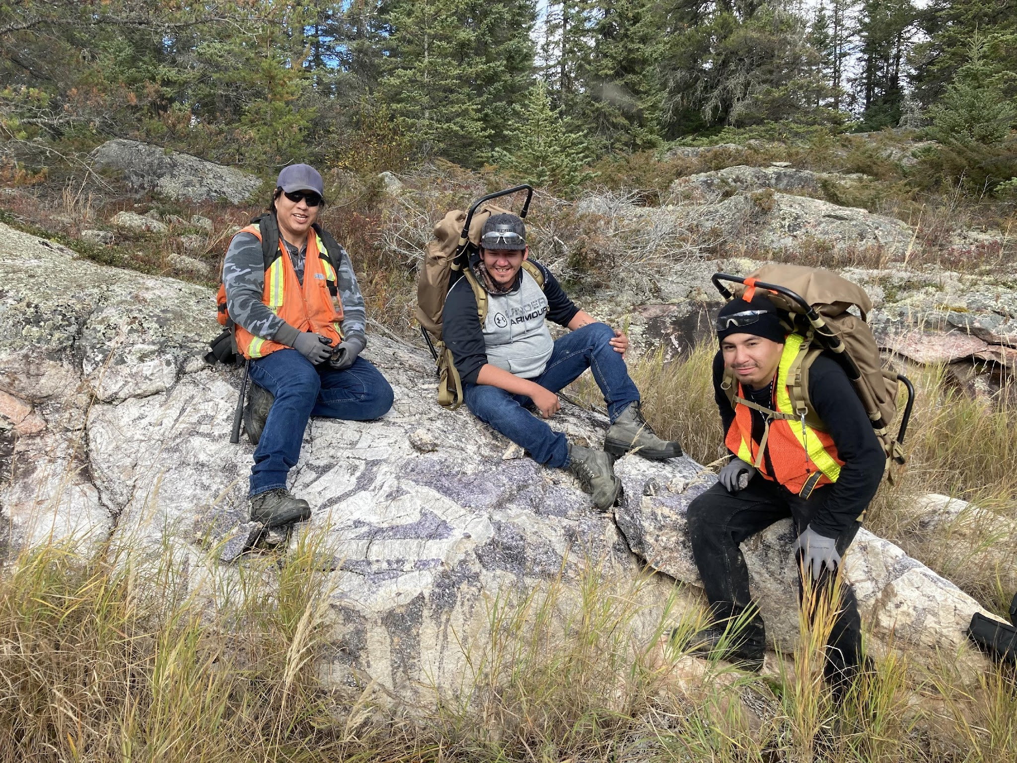

COMMUNITY ENGAGEMENT
ABORIGINAL COMMUNITY RELATIONS
NAM has established strong relationships with aboriginal communities in Ontario and Manitoba
EXPLORATION AGREEMENTS
NAM has long standing agreements with the Temagami First Nation (2014) and the Nipissing First Nation (2022) in Ontario and the Sagkeeng First Nation (2018) in Manitoba, that provide a framework for consultation and collaboration through the exploration and development of our projects
CAPACITY BUILDING
NAM has provided training and employment to aboriginal community members throughout the exploration phases of work at our projects
H2 2026

Slide 9
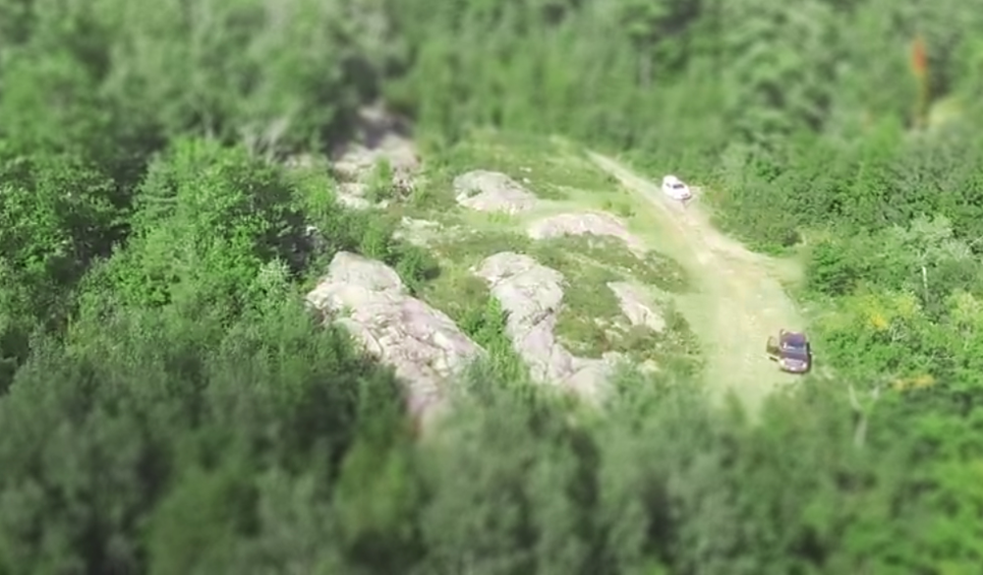
Aerial View of Dana North Outcrops and Access Road– View Looking westwards
PLATINUM GROUP METALS DIVISION
Pd
Pt
Rh
Notes:
The Superstack is no more

Slide 10
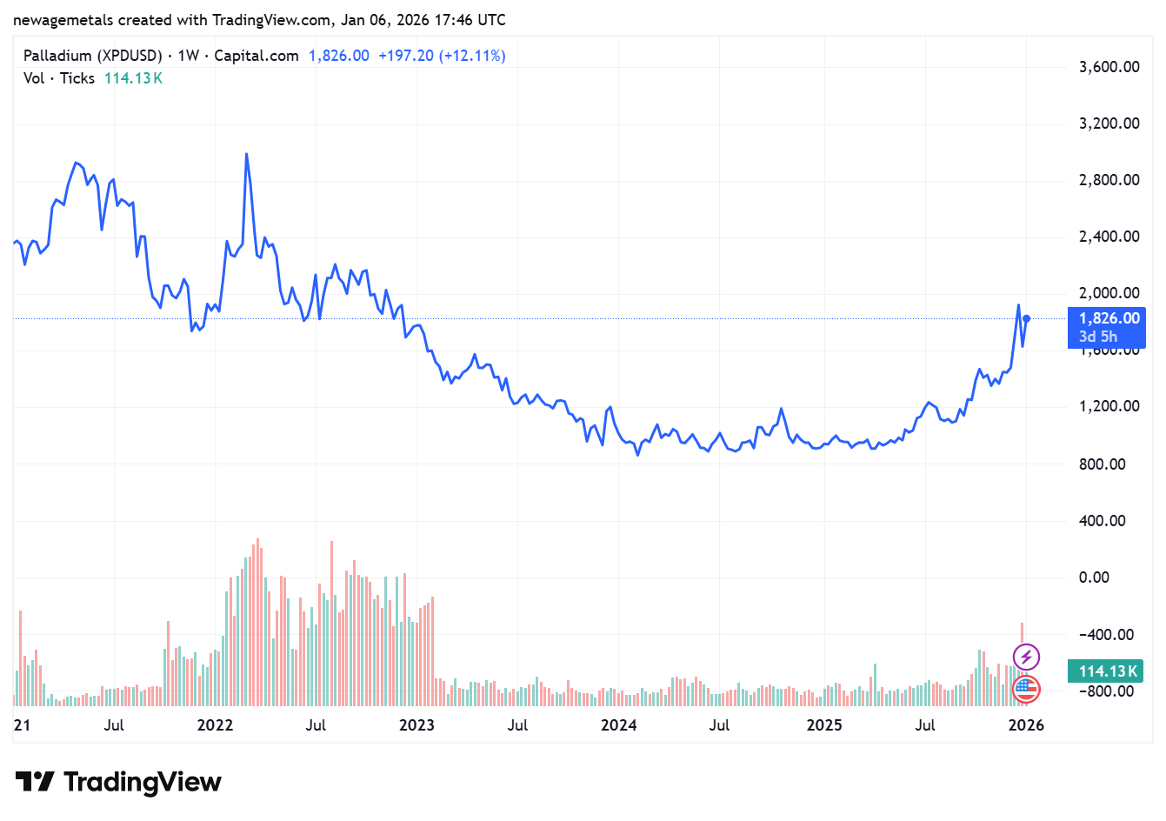
PALLADIUM (Pd) MARKET
Pd in supply deficit since 2012
Auto industry demand ~85%.
Temporary auto chip shortage decreasing demand for Pd. Recovery expected in H2 2022²
Pd is one out of the big 4 precious metals (Gold, Silver, Platinum and Palladium)
More emissions legislation
gives favourable outlook
Russia accounts for 40% Of global Pd exports. Western countries seek alternative Pd supply channels
5 year Price Chart ($USD) for Palladium
H2 2026
Notes:
Lower case easier to read.

Slide 11
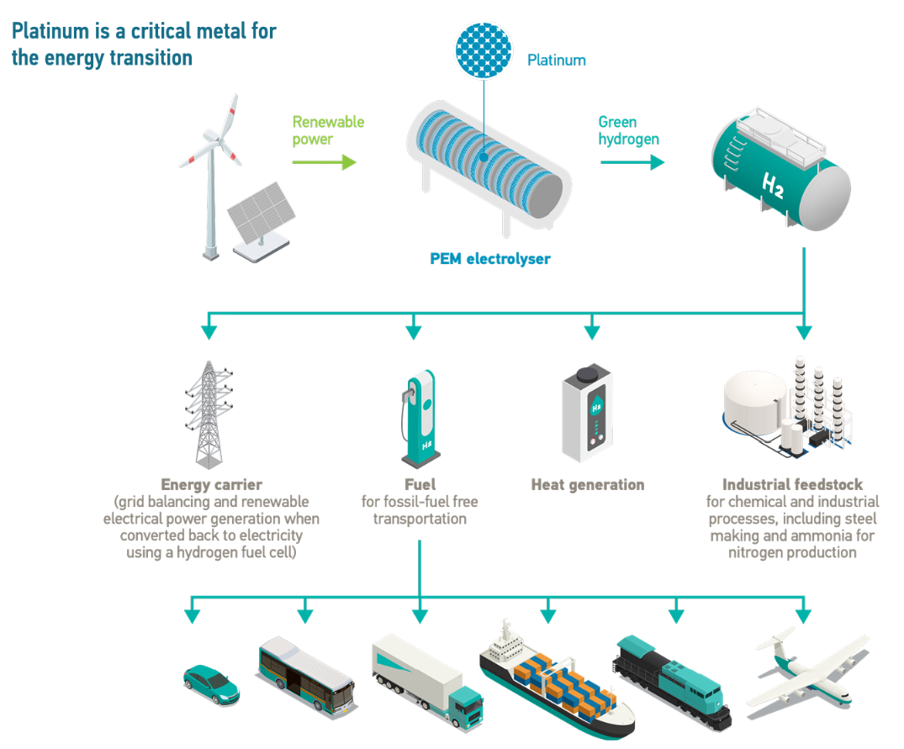
The Future Hydrogen Economy
WPIC 2023
H2 2026

Slide 12
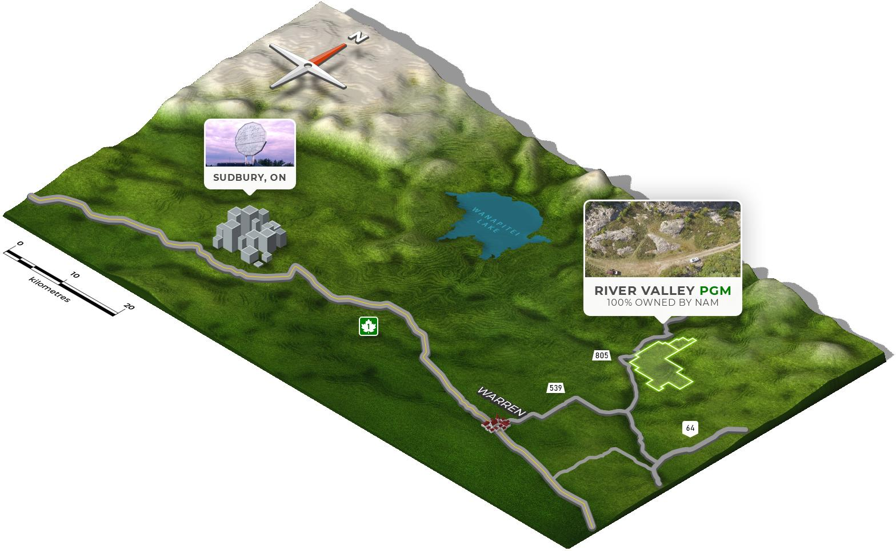

RIVER VALLEY PALLADIUM PROJECT
Located 100 road-km
from Sudbury, Ontario
Long-established, world-class Ni-Cu (PGM) mining district
Major mineral processing
& metal recovery facilities
H2 2026

Slide 13
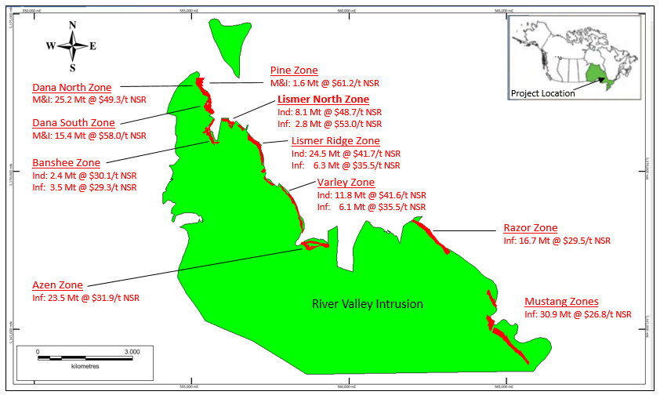
RIVER VALLEY PROJECT OVERVIEW
FACTS^{1(appendix)}
Primary Metals: Project Stage: | Pd, Pt, Cu (Primary PGM Deposit) PEA completed summer 2023
Location: | near City of Sudbury, Ontario
Mineral Resources: | 2.25 Moz Pd+Pt+Au (M+I) & 1.7 Moz (Inf.) (updated October, 2021)
Land Position: | 107 km^{2;} (includes 2 Mining Leases)
Diamond Drilling: | 733 holes totalling >155,00 metres
Ownership: | 100% NAM (subject to 3% NSR)
River Valley Project
(M&I: 89 Mt @ $47.3/t NSR
Inferred: 93 Mt @ $31.1/t NSR)
UPCOMING MILESTONES
2023 Preliminary Economic Assessment completed
PLATSOL leaching test work program
2026 DasVision 3D IP geophysical survey completed in August 2026 over the Mustang Zone to delineate high-priority drill targets. Major drill programs and follow-up on PEA recommendations slated for 2027
Mineralized zones of the River Valley PGM Project, near Sudbury, Ontario
H2 2026

Slide 14
2021 UPDATED MINERAL RESOURCE ESTIMATE RESULTS
At cut-offs of CDN$15/t NSR (pit constrained) and CDN$50/t NSR (out-of-pit), the 2021 Updated Mineral Resource Estimate consists of:
  89.9 Mt grading 0.54 g/t Pd, 0.21 g/t Pt, 0.04 g/t Au and 0.06% Cu, or CDN$47.58/t NSR in the Measured and Indicated classifications; and
  94.0 Mt grading 0.35 g/t Pd, 0.16 g/t Pt, 0.04 g/t Au and 0.06% Cu, or CDN$31.69/t NSR in the Inferred classification.
Contained Metal Contents at CDN$15/t Cut-Off
Pd
PALLADIUM
Pt
PLATINUM
Au
GOLD
Cu
COPPER
Rh
RHODIUM
Pd
Au
Cu
Rh
Ag
Silver
1,568,300 oz
PALLADIUM M+I ¹
1,073,700 oz
INFERRED
606,400 oz
PLATINUM M+I
480,600 oz
INFERRED
106,700 oz
GOLD M+I
94,200 oz
INFERRED
114.7 Mlbs
COPPER M+I
88.1 Mlbs
INFERRED
53,800 oz
RHODIUM M+I
43,700 oz
INFERRED
759,800 oz
SILVER M+I
756,000 oz
INFERRED
¹ M+I = Measured + Indicated classifications
*see Appendix (slide 36) for full results summary and NSR calculations
H2 2026
Notes:
Emphasize Pd

Slide 15
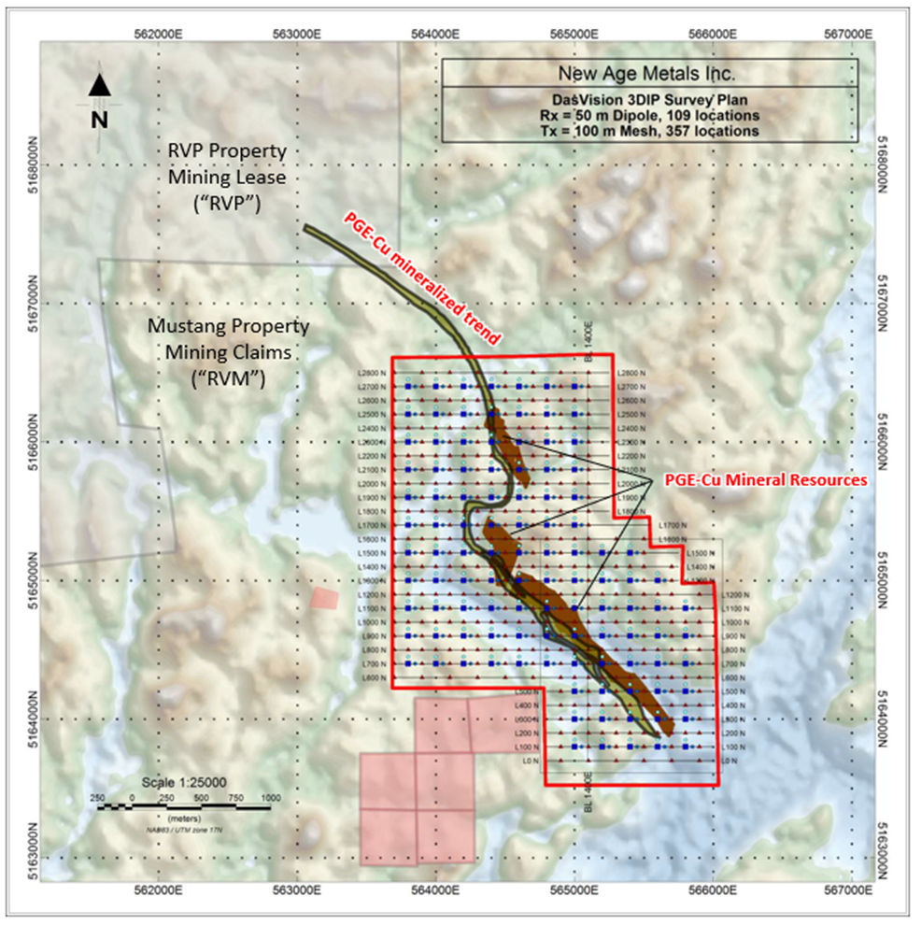
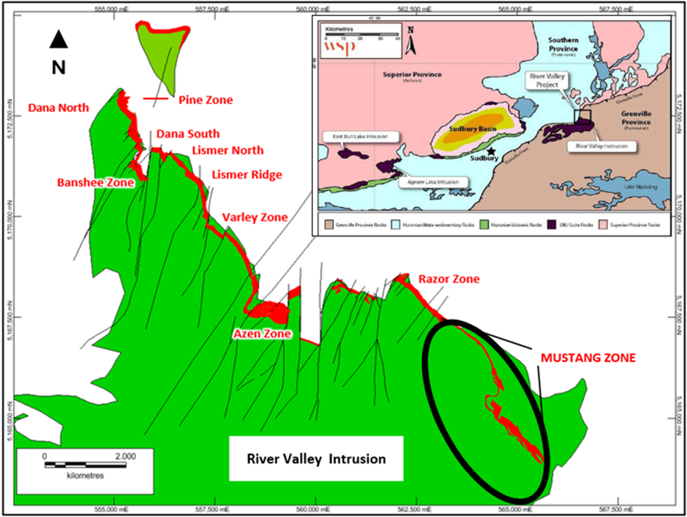
Reestablishing A Resource
2026 results from DasVision 3DIP geological survey outlines high-priority drill targets for 2027 program.
Goal: Reestablish historical resource on Mustang Zone due to previous operators loss of drill core.
H2 2026

Slide 16
River Valley 2023 Preliminary Economic Assessment
Pre-Tax NPV(5%): $296M; After-Tax: $140M
Pre-Tax IRR: 16%; After-tax IRR: 11%
Annual Production: 2.5 Mt of potential process plant feed at an average grade of 1.19 g/t PdEq and process recovery of 71.5%, resulting in an average annual payable Pd production of 47,400 oz.
Total Tonnes Processed over Life of Mine: 38.6 Mt/16 years
Pre-production Capital Requirement: $269M
Average Unit Operating Cost: $30.98/t
Assumed US$ Metal Prices: $2,150/oz Pd, $1,050/oz Pt, $1,830/oz Au, $4.00/lb Cu
River Valley Process Plant Feed: Treated in an on-site conventional sulphide flotation plant to produce a saleable PGM-enriched Cu concentrate for transport off-site for smelting and refining
Project Enhancement Opportunities: Increased metal recoveries and expanded Mineral Resources
H2 2026
Notes:
Goal: Design an Pd mining and processing operation that makes mining and economic sense and enjoys strong stakeholder and community support

Slide 17
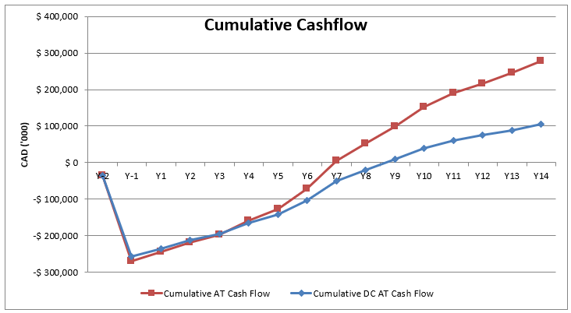
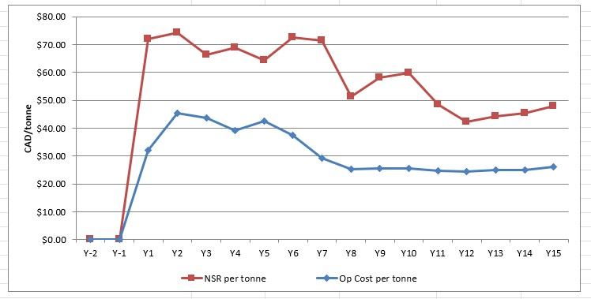
2023 PEA Results
Financial Metrics
Pre-Tax NPV(5%): $296M; After-Tax: $140M
Pre-Tax IRR: 16%; After-Tax IRR: 11%
Pre-Production CAPEX: $269M
Average Unit OPEX: $31/t (value = $71.4/t NSR)
Metal Prices: $2,150/oz Pd, $1,050/oz Pt, $4/lb Cu
Physical Metrics
Annual Production: 2.5 Mt process plant feed
Average Grade: 1.19 g/t PdEq
Process Recovery: 71% Pd
Annual Payable Metal: 47,400 oz Pd
Total Tonnes Processed: 38.6 Mt
Life of Mine: 16 years
Operating Margin
H2 2026
Notes:
RVP makes money in an operation sense, but struggles to pay back CAPEX in an attractive timeframe

Slide 18
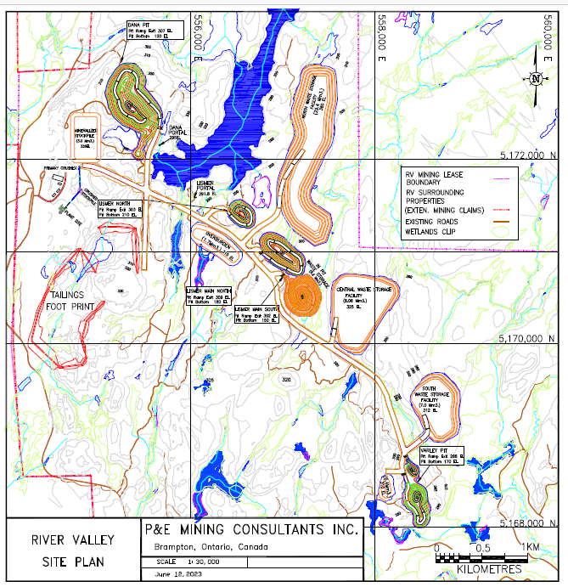
New PEA: Site Layout Plan
Project Components
5 OP Mines
2 UG Mines
3 Waste Rock Piles
1 Overburden Pile
1 Stockpile
1 Tailings Facility
1 Processing Plant
Compared to 2019 PEA
Smaller operation
Lower CAPEX
Reduced environmental footprint
H2 2026

Slide 19
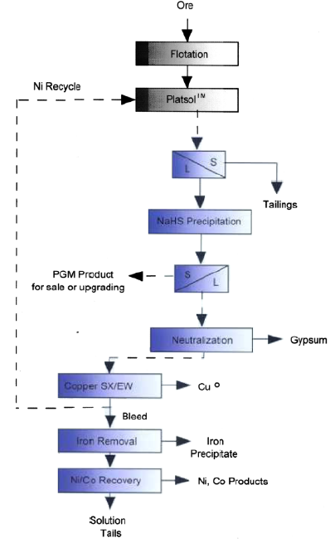
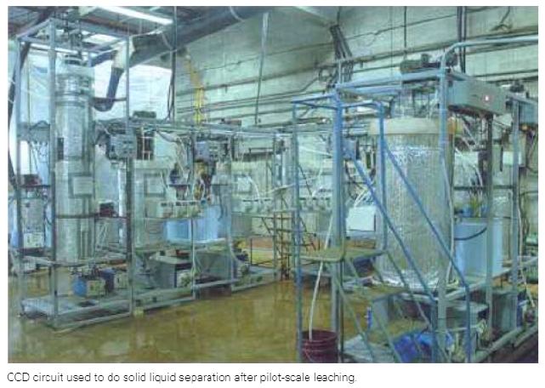
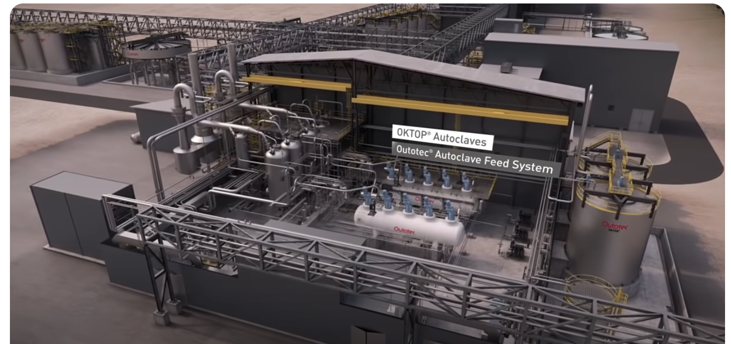
PLATSOL™: What is it?
SGS is a global leader in independent testing, inspection, and certification, operating major labs and technical services across industries.
High-pressure high-temperature acid leach and solvent extraction technique
Optimized for PGM recovery from low-grade, polymetallic sulphide concentrates, like RVP
PGM and Cu recoveries ≥90% in laboratory test work on PGM-bearing concentrates from elsewhere
High-value, direct to refinery product
No smelter, reduced transport costs
Technology proven at laboratory scale, but not yet scaled-up to commercial operation
Source: SGS Mineral Services.
PLATSOL™ process provides a viable alternative to smelting.
Conceptual flowsheet for gold, PGM and base metal recovery from sulphide concentrate.
Conceptual Plant (Outotec)
H2 2026

Slide 20
Next Steps for PLATSOL (River Valley Project)
Advance PLATSOL metallurgical de-risking at RVP
Build on prior laboratory success to further validate a high-recovery, smelter-free processing route for low-grade, polymetallic PGM mineralization.
PLATSOL Program up to ~$500K to unlock downstream value
  ~$400k-500K: Expanded PLATSOL Phase II metallurgical testwork
High-value product pathway
PLATSOL has demonstrated ≥90% PGM and Cu recoveries in comparable concentrates, producing a refinery-ready product with reduced transport and processing costs.
Clear technical milestone
Program designed to assess scalability and economic relevance, informing next-stage development decisions.
Positive federal/provincial engagement
Constructive discussions regarding potential non-dilutive funding and additional grant opportunities.
H2 2026

Slide 21
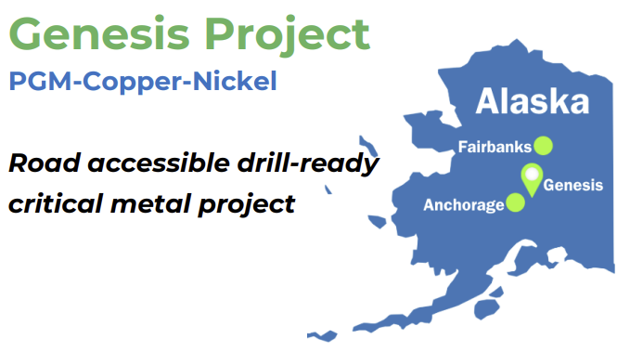
100% OWNED
ROAD ACCESSIBLE/PAVED HIGHWAY & ELECTRIC TRANSMISSION LINE
KNOWN PGM-Cu-Ni MINERALIZATION COVERS 9 KM. SUMMER 2026 SURFACE SAMPLING AND MAPPING PROGRAM
OPTION/JOINT VENTURE WITH ROCKPORT CAPITAL
DRILL-READY PGM-Cu-Ni REEF STYLE TARGET: 2.4 G/T PD, 2.4 G/T PT, 0.96% NI AND 0.58% CU IN SURFACE GRAB SAMPLES
Final 2026 report & go-forward plan slated by year end
H2 2026

Slide 22
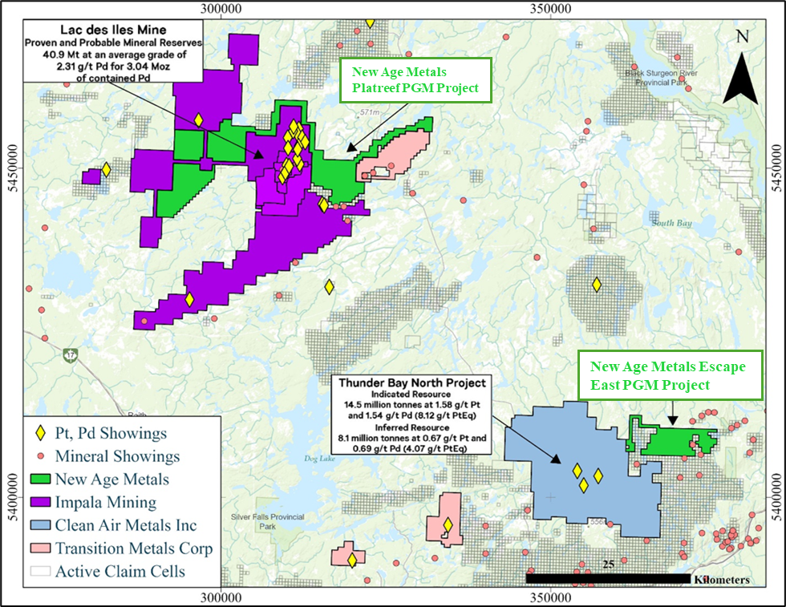
Thunder Bay PGM–Ni–Cu Projects
Platreef PGM Project and Escape East PGM Project
Three PGM–Ni–Cu exploration projects in Northwestern Ontario — Platreef PGM, Escape East PGM, and Gravel Ridge PGM (optioned April 2026) — consolidating ~21,000 hectares (~52,000 acres) proximal to the Lac des Iles Mine.
Projects provide further pipeline exposure to palladium, platinum, nickel, and copper within mafic–ultramafic intrusive geological settings
Proximal to Thunder Bay, a regional mining and logistics hub, with road access to skilled workforce, infrastructure, and service providers.
Located within established PGM mining districts, adjacent to Impala’s Lac Des Iles Mine and Clean Air’s PGM deposit.
Historical exploration completed, including geophysics, prospecting, trenching, and drilling, providing a foundation for follow-up work
Multiple untested or under-tested magnetic and intrusive targets identified across both properties
Straightforward low-cost exploration strategy prior to drilling
Gravel Ridge PGM Property optioned April 16, 2026 — adds ~2,129 ha (~5260 acres) adjacent to the Lac des Iles Mine, further consolidating NAM's land position within the Lac des Iles intrusive complex.
H2 2026

Slide 23
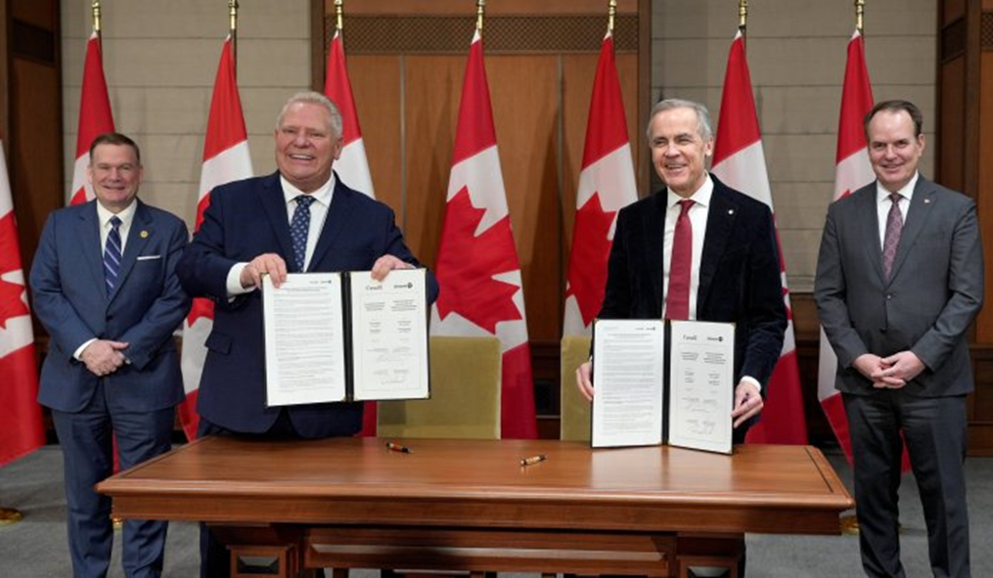
Why the Ring of Fire?
Major cycle resets create mispriced assets: large projects can stall for years due to infrastructure + permitting complexity
Cliffs example (reset moment): in 2015, Cliffs sold its Ring of Fire chromite assets to Noront for US$20M — a clear “distressed-value” entry point for the next owner
Wyloo example (re-rating moment): Wyloo completed its acquisition of Noront in 2022, signaling renewed long-term conviction in the district
Policy tailwind strengthens the “why now”: governments are actively moving to streamline approvals for key infrastructure (incl. the Ring of Fire road)
What this means for NAM: NAM aims to enter early, when valuations are still “pre-infrastructure,” to secure district-scale optionality at low cost (before the next capital wave)
Prime Minister Mark Carney and Ontario Premier Doug Ford.
Ontario's accelerated Ring of Fire road plan was announced at PDAC March 2026. The Webequie Supply Road began construction in June 2026 and the The Marten Falls Community Access Road began construction in September 2026 and both open by November 2030. The Marten Falls Community Access Road follows in August 2026.
Source;The Webequie Supply Road, The Marten Falls Community Access Road
Harry Barr, CEO NAM states, “As Chairman and CEO, our stated corporate objective is to become one of the largest project exploration and development companies in the Ring of Fire region. Over my career, our Board of Directors, and our technical and financial teams have consistently delivered on this objective across multiple international jurisdictions, and we intend to do the same here..”
H2 2026
Notes:
Add ROF 1 PR info after this slide

Slide 24
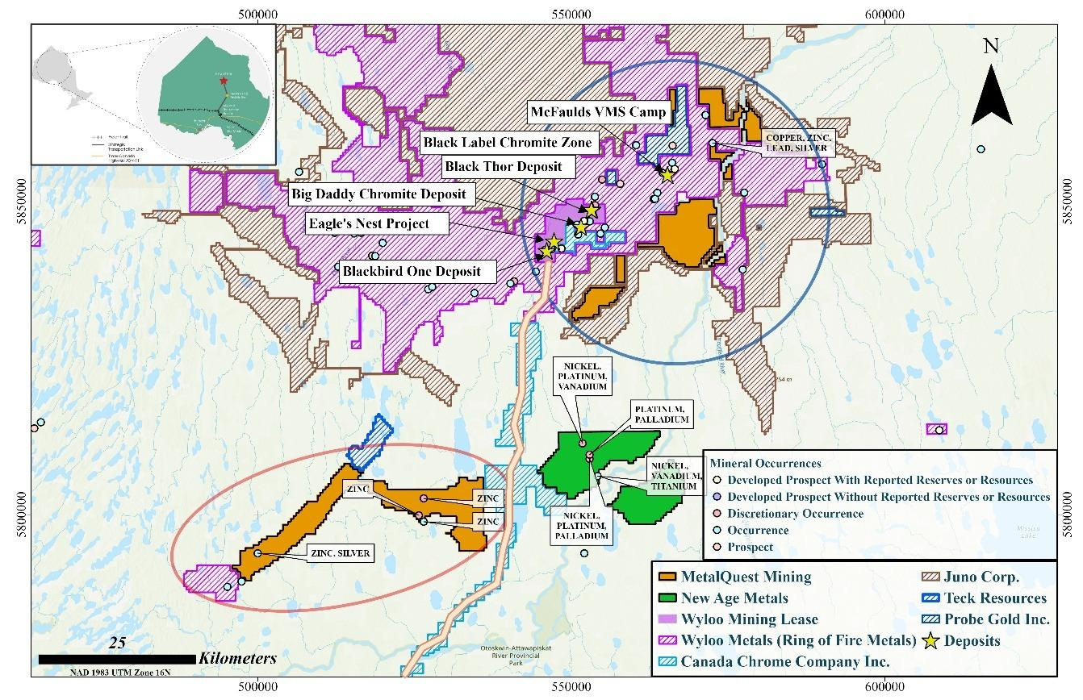
NAM’s Northern Shield PGM-Cu-Ni Project in Ontario’s Ring of Fire Region
100% owned (staked) — no option payments or earn-in obligations
Located in Ontario’s Ring of Fire, a highly prospective emerging critical minerals district~34,000 hectares (84,000 acres) covering the full extent of the layered mafic intrusive complex, following southern extension (Feb 2026) and northern extension (Apr 2026).
Strong historical database: airborne & ground geophysics, soils, mapping + >7,000 m drilling
Mineralized system confirmed with PGM reef-style horizons and net-textured sulphides
Multiple priority targets identified — largely untested along strike and at depth
Drill-ready targets outlined by previous operators — clear follow-up potential
Work underway: data compilation + grassroots programs to refine targets ahead of drilling
District momentum confirmed — Ontario's accelerated road plan began construction start June/Sept 2026, with first roads opening November 2030
Location map of the newly acquired Northern Shield claim blocks showing proximity to the proposed Ring of Fire access road (orange line) and selected regional PGM, VMS, and chromite deposits shown for regional context only.
Harry Barr, CEO New Age Metals states, “Northern Shield is exactly the type of opportunity we look for at New Age Metals. The property was acquired at very low cost through staking, yet benefits from extensive historical exploration, including drilling that confirmed PGM-bearing, base metals, and vanadium (polymetallic) reef horizons and sulphide mineralization
H2 2026
Notes:
Add ROF 1 PR info after this slide

Slide 25
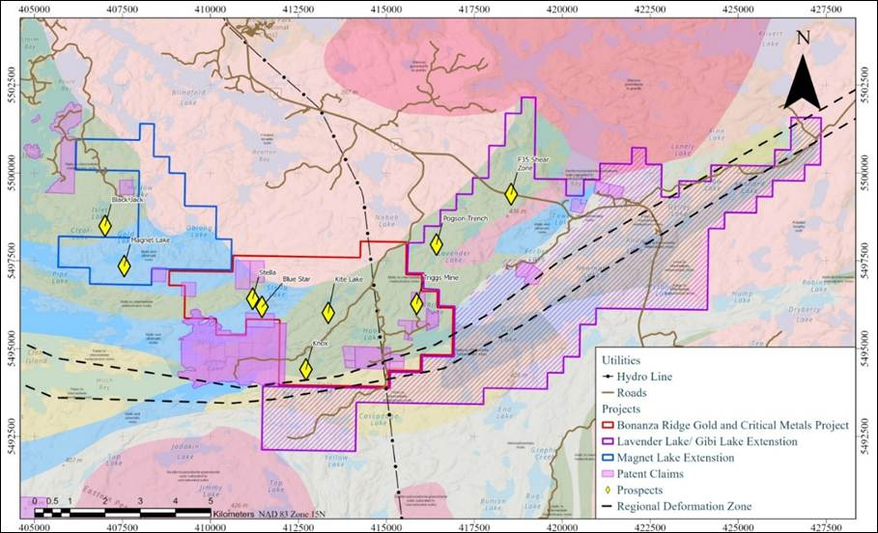
Bonanza Ridge Gold and Critical Metals Project: Kenora Mining District
Aggressively consolidating District Scale Projects
Multiple high-grade mineral occurrences of gold at surface including Select due diligence surface grab sample assays:
1.1 g/t Au, 3.7 g/t Au, 8.9 g/t Au, 13.2 g/t Au, 22.2 g/t Au, 31.9 g/t Au and up to 127 g/t Au from five prospects on the Project;
Excellent infrastructure, including road access to all areas to the Project and provincial grid power lines;
Project expanded via Lavender Lake and South Gibi Lake option agreements (Dec 2025), adding ~5,216 hectares (~12,889 acres) along the same structural corridor.
Location 25 km southeast of City of Kenora, a major northwestern Ontario economic hub with a population of ~14,800;
Lack of modern-day exploration; and Drill-ready with 3-year permits in place.
Aggressive 2026 program of trenching, channel sampling and prospecting
Objective is to outline drill targets for 2027
H2 2026

Slide 26
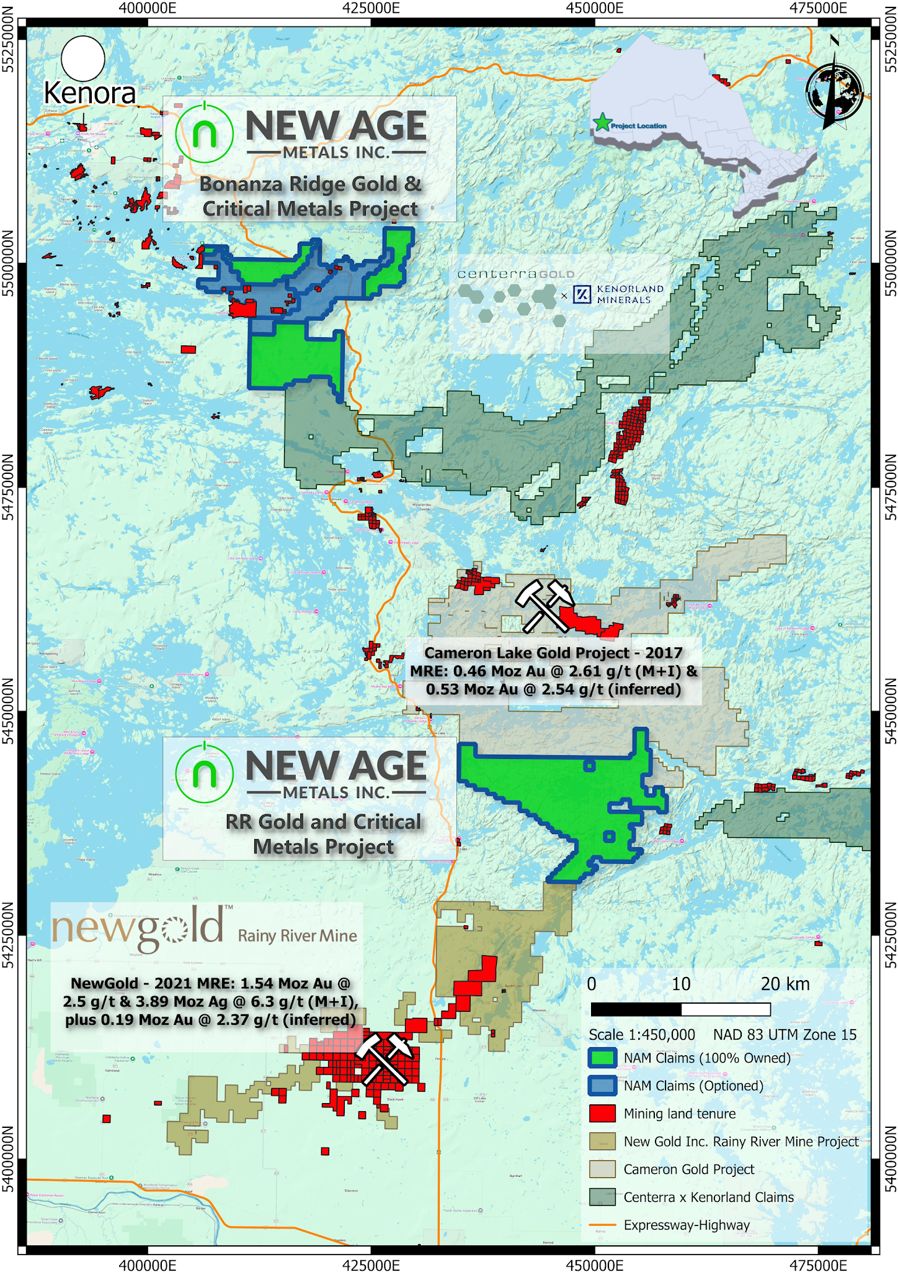
Golden Acquisitions: Kenora Mining District
Double RR Gold Project Acquisition
District-scale land position totaling 17,620 hectares in the Rainy River–Kenora gold district
Located approximately 35 km northwest of the Rainy River Gold Mine (~2.2M ounce Au in reserve 2024) and ~17 km south of the Cameron Lake gold deposit (>1M ounce Au)
Historical OGS till sampling reported up to 25 gold grains within the project area
District Transactions:
Coeur Mining (2026): Coeur Mining completed its acquisition of New Gold Inc. (including the Rainy River mine) in an all-stock deal valued at ~US$7B.
Cameron (2025): First Mining sells to Oronova/Seva, a Frank Giustra company, for C$27M (C$5M cash + 80M shares + ≥C$2M stockpile payment); Seva formed with First Mining retaining ~48%.
Kenorland–Centerra (2025): Centerra can earn 70% of Flora/W. Wabigoon/Algoman by spending C$10M for 51% (incl. C$3.5M Y1 + 10 km drilling) and completing a 1 Moz AuEq PEA for the remaining 19%.

Slide 27
High-level summary of recent deals in the
Kenora Mining District
Kenorland–Centerra (2025): Centerra can earn 70% of Flora/W. Wabigoon/Algoman by spending C$10M for 51% (incl. C$3.5M Y1 + 10 km drilling) and completing a 1 Moz AuEq PEA for the remaining 19%.
Coeur Mining (2026): Coeur Mining announced it will acquire New Gold (which includes the Rainy River mine) in an all-stock deal valued at ~US$7B, expected to close in the first half of 2026 (subject to approvals).
Cameron (2025): First Mining sells to Oronova/Seva for C$27M (C$5M cash + 80M shares + ≥C$2M stockpile payment); Seva formed with First Mining retaining ~48%.
H2 2026

Slide 28

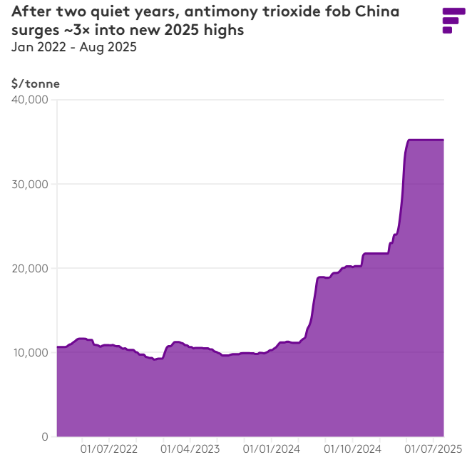
NEWFOUNDLAND
GOLD-ANTIMONY DIVISION
Why Antimony (Sb)?
High-value, supply-constrained metal
Antimony prices remain elevated due to limited global production and long-term supply constraints.
China-dominated supply chain
China controls the majority of global antimony production and refining, creating supply risk for Western markets.
Recognized Critical Mineral
Antimony is listed as a Critical Mineral in Canada, the U.S., and the EU, reflecting its strategic importance.
Essential industrial and defense uses
Key applications include flame retardants, alloys, electronics, and defense-related materials with limited substitution.
Strategic opportunity for secure Western supply
Few advanced antimony projects exist in stable jurisdictions, increasing the strategic value of new discoveries.

Slide 29
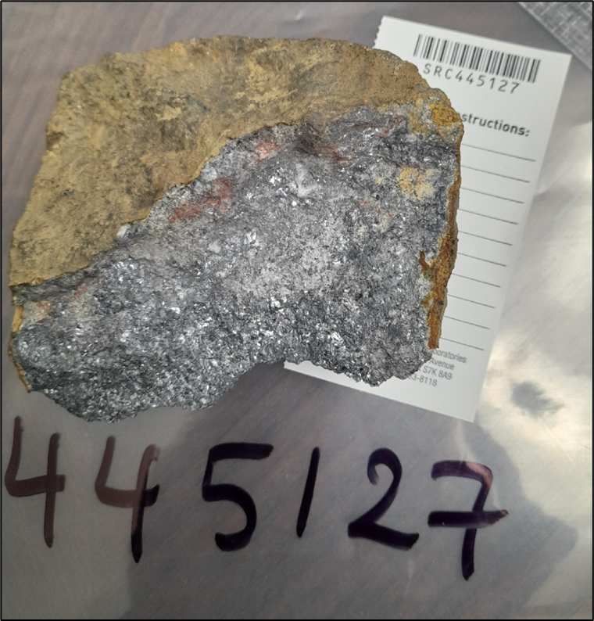
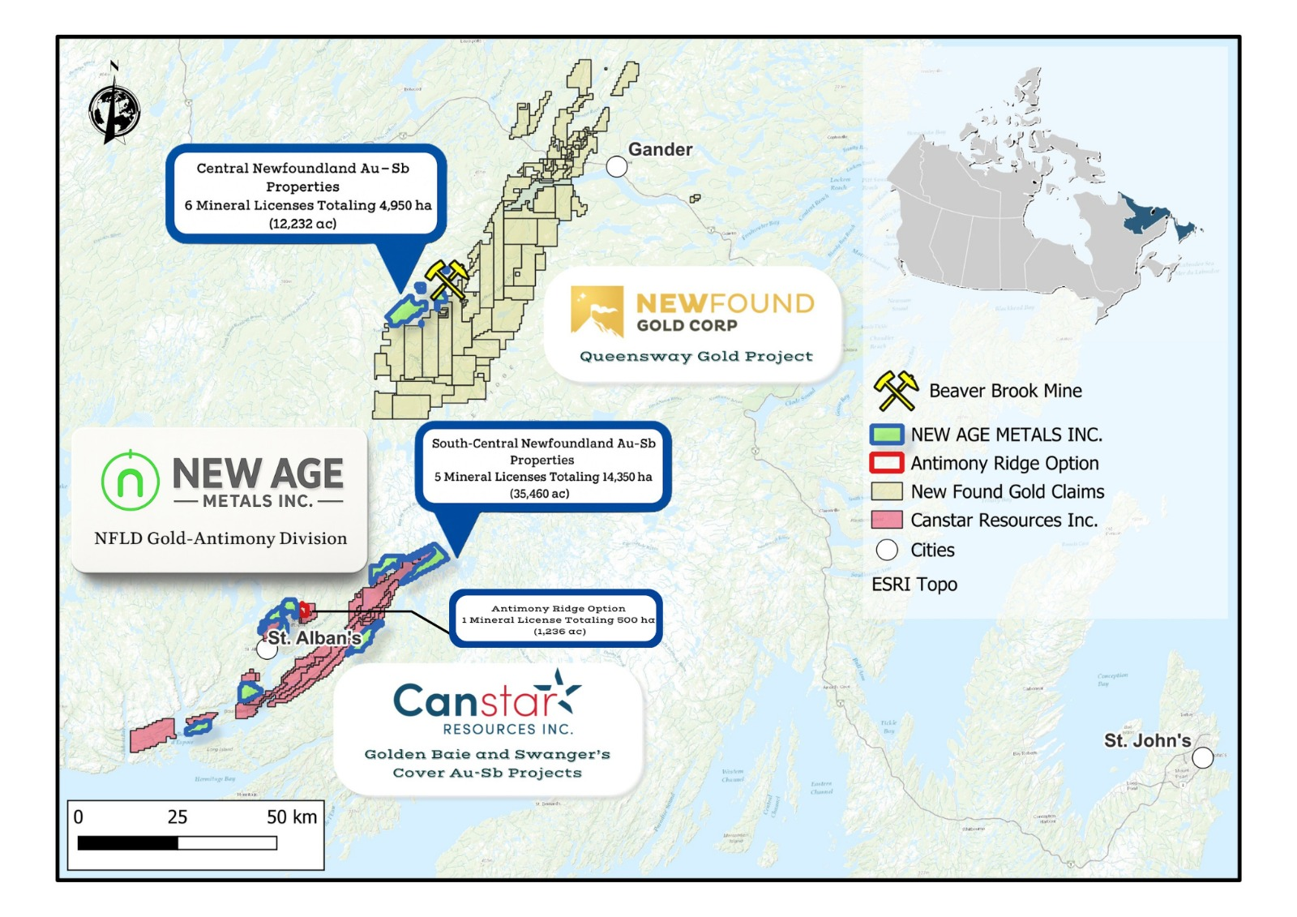
NEWFOUNDLAND
GOLD-ANTIMONY DIVISION
High-grade angular stibnite float sample 445127 from the Antimony Ridge property that graded 51.9% Sb
Overview
NAM acquired 765 mineral claims totalling 20,950 hectares of crown land across 12 non-contiguous properties in Newfoundland and Labrador in H1 2025.
Phase 1 and 2 Highlights
High-grade samples: up to 51.9% & 17% Antimony, 1.5 g/t Gold, 131 g/t Silver, 29.3% Lead (Updated assays pending release)
Multiple discoveries made in 1st season: Established a ~10 km Antimony/Gold trend
Confirmed multi-commodity potential (Ag–Pb–Zn–Cu) across NAM’s southern St. Alban’s properties
Go-Forward Plan
Targeted follow-up exploration is now underway, focused on advancing Phase 1 and 2 surface discoveries
Aggressive fall 2026 trenching and sampling program.
Objective to confirm drill targets for 2027
Newfoundland Gold-Antimony Properties
H2 2026
H2 2026

Slide 30
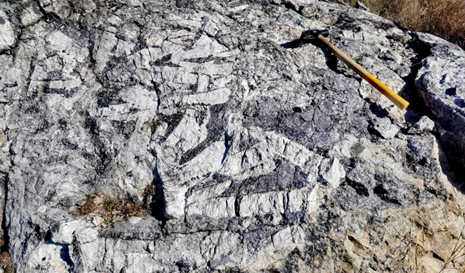
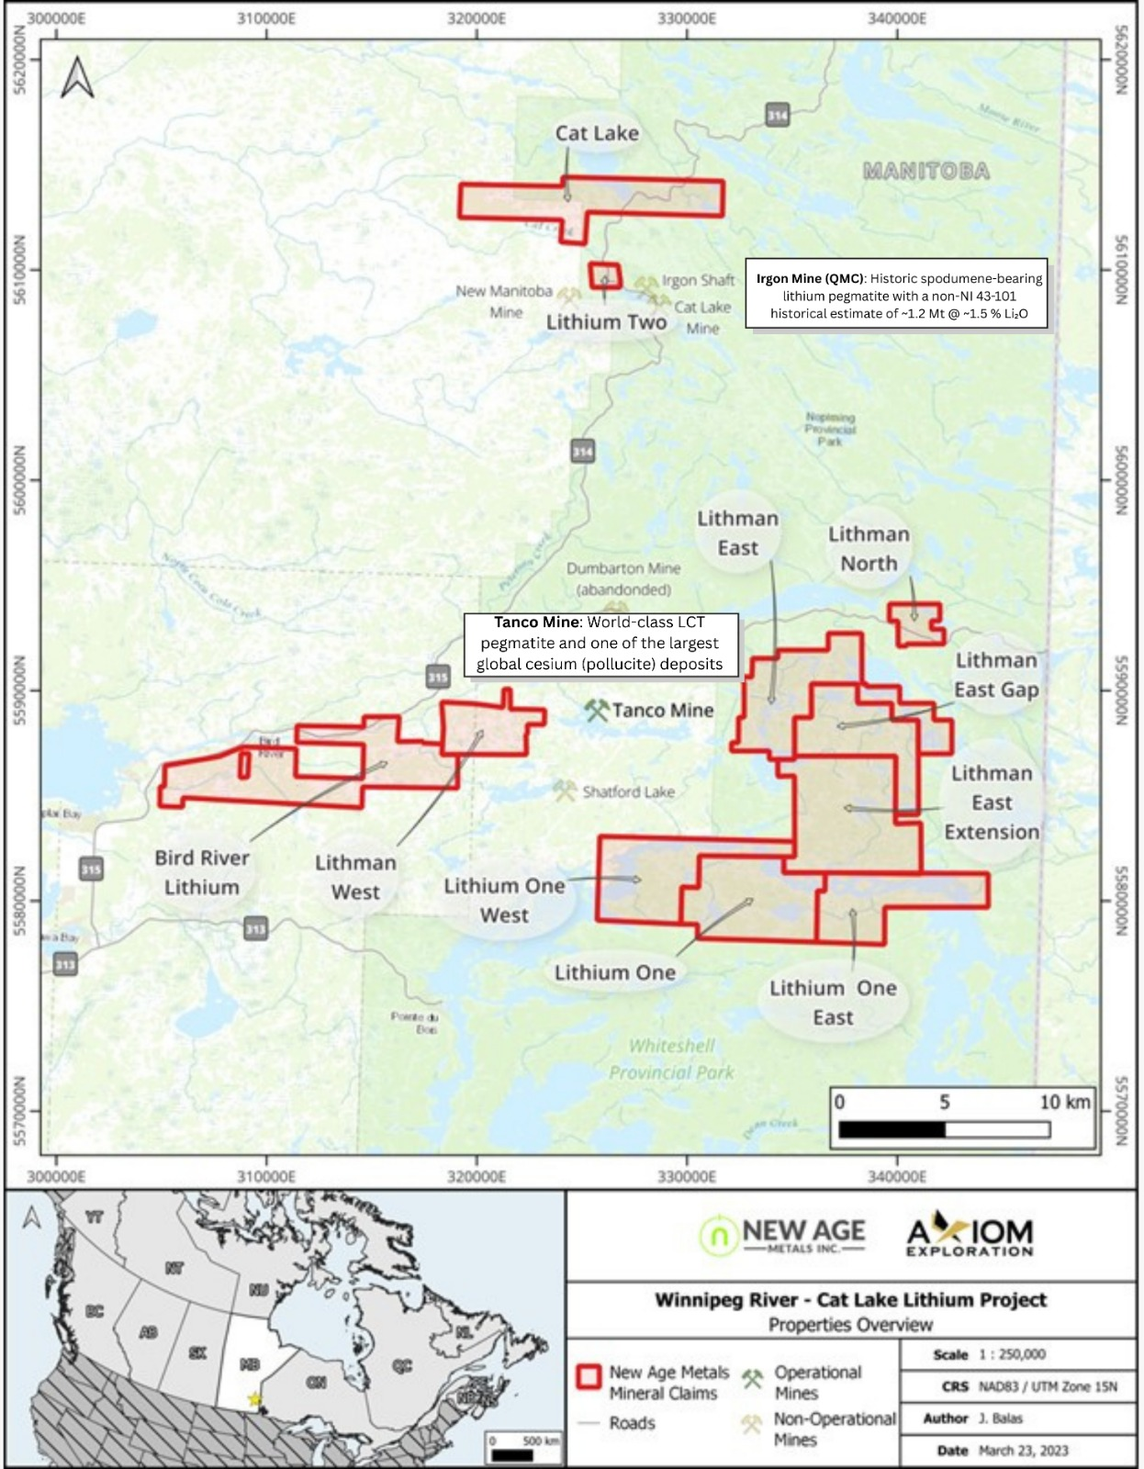
NAM LITHIUM & RARE EARTH PROJECTS
District-Scale Lithium & Rare Metals Project
Large project portfolio in the Winnipeg River Pegmatite Field, hosting LCT-fertile stratigraphy with lithium and associated rare metals including tantalum, cesium, rubidium, gallium, and beryllium, confirmed through surface and drill geochemistry.
Strategic Proximity to the World-Class Tanco Mine
Claims surround and directly flank the producing Tanco Mine, sharing Bernic Lake Group stratigraphy and key structural corridors that host long-life lithium, cesium, tantalum, and related rare-metal mineralization.
Extensively Drill-Tested & De-Risked
18,469.5 m of diamond drilling completed, supported by extensive surface geochemistry and multi-technique geophysics. ~$11 million spent to date and strengthened by a $1.5M NSERC Alliance grant (Apr 2024) with leading academic and industry partners.
Go-Forward Plan
The company has a recommended exploration budget of +$3 million which would include drilling on several of its southern projects.
SouthBay Project Northern Manitoba
Fall 2026 boots on the ground/surface sampling program focusing on beryllium, lithium, tantalum and cesium
H2 2026

Slide 31
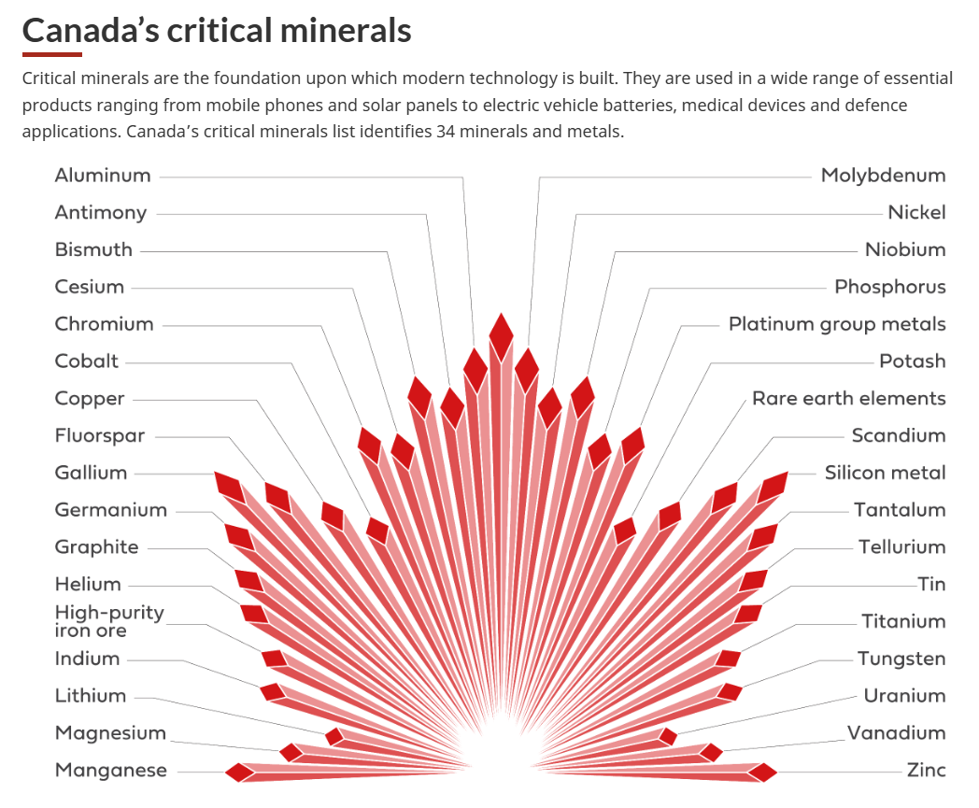
Why Canada? Why Now?
Why Canada?
Top-tier mining jurisdiction with strong rule of law and ESG standards
Established Indigenous consultation and partnership frameworks
World-class geological endowment and skilled mining workforce
Existing infrastructure and mature mining supply chain
Why Now?
Global supply chain realignment prioritizing secure, allied sourcing
Critical minerals formally designated as strategic by Canada and allies
Federal Budget 2025 commitment:
                ~$2B sovereign fund for critical minerals
Expanded exploration tax credits (additional designated minerals)
Reinforced Critical Minerals Strategy
Provincial and federal support via:
Exploration grants and incentive programs
Flow-through shares and tax credit enhancements
Infrastructure and regional development funding
H2 2026

Slide 32
Project Summary
Thunder Bay PGM–Ni–Cu, Ontario
  Platreef/ Gravel Ridge project expanded to ~21,000 hectares (~52,000 ac) , complementing Escape East project near the Clean Air T-Bay North (1.274m-oz of Pt+Pd, 60k t of Cu & 36k t of Ni
  Well established mining district, excellent infrastructure
  Fall program with boots on ground / geophysics
Gold & Critical metals – Bonanza Ridge Project, Kenora
  District-scale gold project with high-grade historic workings
  Aggressive regional exploration program underway
  Second district scale Double R Gold project
  Goal to identify drill targets for early 2027
Gold–Antimony – Newfoundland
  11 projects in a top-tier mining jurisdiction
  High-grade gold and critical antimony focus
  Aggressive acquisition & exploration programs underway
  Drill ready by early 2027
Lithium | Tantalum | Cesium | Beryllium – Manitoba
  100% NAM ownership via Lithium Canada Development
  $11m spent to date. Numerous drill targets, $3m geological / drill budget recommended
~14.39% equity interest in MetalQuest Mining Inc.
(Lac Otelnuk/Superior Iron/Ring of Fire/Cameron)
Strategic Shareholder​
Eric Sprott one of the world’s best known mining financiers and owns +30%​
Core Asset Divisions​
Flagship PGM – River Valley (Ontario)​
  100% owned, multi-million-ounce Pd–Pt–Rh–Cu–Au district​
  ~60 road miles from Sudbury, North America’s largest metallurgical complex​
  2026 Program includes 3D IP Geophysical survey to generate high-priority drill targets
  PLATSOL studies to increase metallurgical recoveries
  Pathway to feasibility study
Northern Shield PGM–Ni–Cu – Ring of Fire, Ontario
  Northern Shield now totals ~34,000 hectares (84,000 acres) following southern extension and northern extension.
  Government begins construction of an all-season access road in September 2026
Genesis Cu–Ni–PGM (Alaska)​
  100% owned, road-accessible, drill-ready​
  August 2026 exploration program completed, results by year end​
H2 2026
NEWAGEMETALS.COM • TSX.V: NAM • OTCQB: NMTLF • FSE: P7J2
H1 2026

Slide 33





THANK YOU
FOR MORE INFORMATION CONTACT US AT :
1-613-659-2773
info@newagemetals.com
SIGN UP TO RECEIVE COMPANY UPDATES :
https://newagemetals.com/join
H2 2026
NEWAGEMETALS.COM • TSX.V: NAM • OTCQB: NMTLF • FSE: P7J2
H1 2026

Slide 34
APPENDIX
H2 2026
NEWAGEMETALS.COM • TSX.V: NAM • OTCQB: NMTLF • FSE: P7J2
2026

Slide 35
MINERAL RESOURCE ESTIMATES 2021
NOTES
Mineral Resources that are not Mineral Reserves do not have demonstrated economic viability.
The estimate of Mineral Resources may be materially affected by environmental, permitting, legal, title, taxation, socio-political, marketing, or other relevant issues.
The Inferred Mineral Resource in this estimate has a lower level of confidence than that applied to an Indicated Mineral Resource and must not be converted to a Mineral Reserve. It is reasonably expected that the majority of the Inferred Mineral Resource could potentially be upgraded to an Indicated Mineral Resource with continued exploration.
The Mineral Resources were estimated in accordance with the Canadian Institute of Mining, Metallurgy and Petroleum (CIM), CIM Standards on Mineral Resources and Reserves, Definitions (2014) and Best Practices Guidelines (2019) prepared by the CIM Standing Committee on Reserve Definitions and adopted by the CIM Council. Numbers may not add exactly due to rounding.
The Mineral Resource Estimate is based on US$ metal prices of $1,850/oz Pd, $900/oz Pt, $1,600/oz Au, $3.00/lb Cu, $16/lb Co, $6.50/lb Ni, $8,000/oz Rh, $18.50/oz Ag. The US$:CDN$ exchange rate used was 0.75.
The NSR estimates use flotation recoveries of 80% for Pd, 80% for Pt, 80% for Au, 85% for Cu, 25% for Co, 90% for Ni, 80% for Rh and 65% for Ag and smelter payables of 80% for Pd, 80% for Pt, 85% for Au, 85% for Cu, 50% for Co, 90% for Ni, 80% for Rh and 65% for Ag.
The pit optimization used a mining cost of $2.25/t mined, combined processing and G&A costs of CDN$15/t, and pit slopes of 50º. The out-of-pit Mineral Resources used underground mining, processing and G&A cost of CDN$50/t.
Pit Constrained Cut-off = CDN$15/t NSR and Out-Of-Pit = CDN$50/t NSR Cut-offs
 | Tonnes ’000 | Pd g/t | Pt g/t | Rh g/t | Au g/t | Cu% | Ni% | Co% | NSR (C$/t)
Measured | 15,488 | 0.70 | 0.25 | 0.02 | 0.05 | 0.07 | 0.02 | 0.003 | 59.54
Indicated | 74,152 | 0.51 | 0.20 | 0.02 | 0.04 | 0.06 | 0.01 | 0.002 | 45.08
Measured + Indicated | 89,640 | 0.54 | 0.21 | 0.02 | 0.04 | 0.06 | 0.01 | 0.002 | 47.58
Inferred | 94,268 | 0.35 | 0.16 | 0.01 | 0.03 | 0.04 | 0.02 | 0.002 | 31.69
 | Pd Moz | Pt Moz | Au Moz | Cu Mlbs
Measured | 0.347 | 0.122 | 0.022 | 23.70
Indicated | 1.221 | 0.484 | 0.084 | 91.00
Measured + Indicated | 1.568 | 0.606 | 0.106 | 114.7
Inferred | 1.073 | 0.480 | 0.094 | 88.1
H2 2026
Notes:
This slide must be included

